Slide 1
Rethinking Patient Safety: Promoting a new approach for safer care at [name of organization]
Please insert your organization’s logo
Presenter: X
Date: X
Notes:
I’m delighted to join you today to suggest a new approach to patient safety for our organization, and to encourage all of us at [name of organization] to champion it to improve care for our patients / residents / clients.
It’s also an approach being championed by Healthcare Excellence Canada who provides excellent tools and resources that can support us.

Slide 2
Everyone deserves safe and high-quality healthcare.
Notes:
To begin, let’s start with why.
At [name of organization], we believe everyone deserves safe and high-quality healthcare.

Slide 3
Unfortunately, this is not always the case.
Notes:
But unfortunately, this is not always the case.
At [name of your organization], our harm data tells us … [suggest you share examples of your organization’s harm statistics from incident reporting, hospital harm data, other applicable data, or media stories, etc.].

Slide 4
Placeholder slide for organization to add any imagery of their data

Slide 5
Pull quotes
‘Twenty years since the Canadian Adverse Events Study, too little has been done to move the needle on Patient Safety’.
Dr. G. Ross Baker, Professor Emeritus; University of Toronto, Canada. National Post, July 26, 2023
The lack of progress is “disturbing”
Donald M. Berwick, MD, MPP, President Emeritus and Senior Fellow, Institute for Healthcare Improvement
Notes:
In fact, it’s been nearly 20 years since the Canadian Adverse Events Study estimated that up to 9,250-23,750 people die each year in Canada’s hospitals alone from potentially preventable healthcare harm.
.
To quote Dr. Ross Baker, a co-author on this study and professor emeritus at the Institute of Health Policy Management and Evaluation at the University of Toronto “… too little has been done to move the needle … I worry that we have not spent the time and resources in recent years to make a difference, and that we are giving up the opportunity to really reduce the harm that occurs in healthcare.”
And to quote Dr. Donald Berwick, an international healthcare safety expert who recently published an editorial in the New England Journal of Medicine, “The lack of progress is disturbing.”

Slide 6
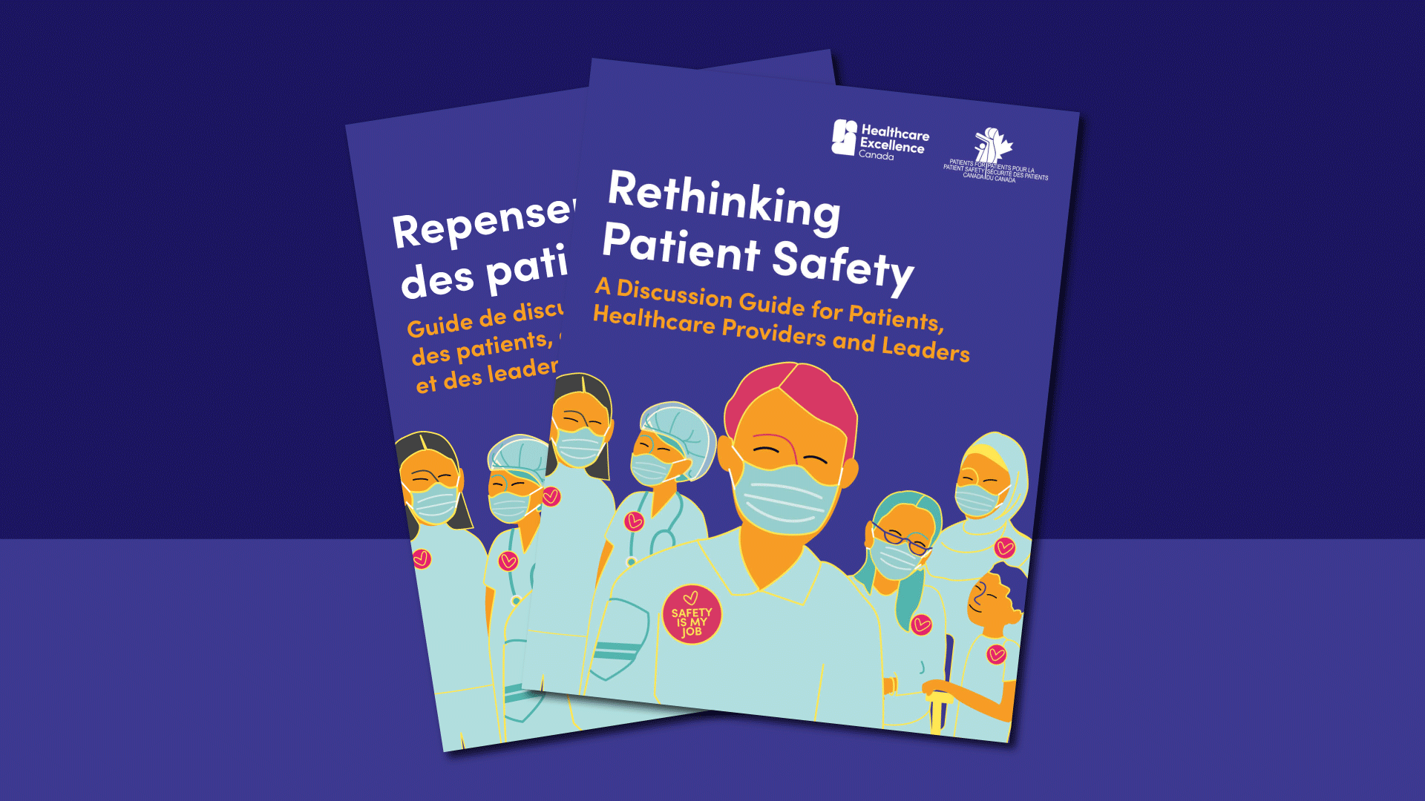
A graphic of two patient safety guides. Image text: Rethinking Patient Safety. A discussion Guide for Patients, Healthcare Providers, and Leaders
Notes:
Bottom line, patient / resident / client harm remains a deadly threat in Canada and all of us in healthcare delivery should be rethinking patient safety.
Thankfully, new thinking is emerging on a new approach to safer care in Canada, with the help of Healthcare Excellence Canada.

Slide 7
How safe is our care?
Notes:
Let’s begin by asking ourselves, how safe is our care?
Please take a few minutes to think and reflect how you would answer this question if asked by a leader, board member, patient/resident/client or care partner, and discuss your reflections with the person next to you.
Debrief:
Ask for a volunteer to describe how they answered the question.
At [name of your organization], we don't have a good way to answer this question. We, like most other organizations, have attempted to answer this question by measuring how much harm is in our system, versus answering how safe is our care.

Slide 8
Does the absence of harm mean we are safe?
HARM
≠
SAFE
Notes:
Does the absence of harm mean we are safe?
We have learned that the absence of harm is not the same as the presence of safety.
Let me repeat: the absence of harm is not the same as the presence of safety.

Slide 9
Do measures of harm tell us: How safe our care is? OR How lucky we have been?
Notes:
To begin, let’s start with why.
Let us now ask ourselves if measuring harm is a good and reliable indicator of how safe our care is, or is it simply an indication of how lucky we have been?
Ask participants to pause and reflect on this question. If comfortable, ask them to have conversations with the people beside them.
Ask participants also to think of an example where they relied on luck in the absence of safety (professionally or personally).
Debrief:
Ask participants to share their reflections of the question or an example of their own experience

Slide 10
Preventing Harm
Toolkits & Check list
Committees
Responsibility of Managers and QI-Safety Departments
Patient Safety projects
Assurance & accountability
Score cards and audits
Incident Management
Policies, rules & guidelines
Notes:
With such a heavy focus on measuring harm, it tips the scale toward patient safety strategies that primarily focused on preventing harm which have relied heavily on hierarchical approaches.
On this slide, you will see many strategies that we at [name of organization] and others use to prevent patient / resident / client harm.
Ask participants: Do these strategies resonate with you? Are there other strategies you can think of?
Ask participants: Do you believe these strategies work to reduce patient harm at [name of organization]? Have our rates of harm improved over the years?
Although, we know many of these initiatives and strategies are important elements to safe care, we are learning they are not enough to help move the mark on safety. Despite [X] number of years of hard work at [name of organization], our rate of patient / resident / client harm has remained unchanged / become worse / shown minimal improvement.
The hierarchical- harm focused approach displayed in this slide is off balance and has not been successful in achieving safer healthcare.

Slide 11
Do these approaches contribute to a workforce that is:
Discouraged
Disengaged
Overwhelmed
Overworked
Lacking psychological safety?
Notes:
Furthermore, the safety experts are beginning to see that this harm prevention approach to safety contributes to workforces feeling discouraged, overworked and lacking psychological safety.
Ask participants: Do you feel like this? (show of hands)
Ask participants:
Let us think about what we do at [name of organization] when things go wrong?
Is our approach and strategy to layer on more policies and enforce more rules?
Is this helping or distracting us from efforts to keep staff and patients / residents / clients safe?

Slide 12
Is our history teaching us that we need to do things differently?
Notes:
Is our own history teaching us that we need to do things differently?
Look for feedback from participants. Are folks engaged/nodding their head in agreement?

Slide 13
The Measurement and Monitoring of Safety Framework
Past Harm
Has patient care been safe in
the past?
Integration & learning
Are we responding and improving
Reliability
Are our clinical systems & processes reliable?
Safety
measurement & Monitoring
Anticipation & Preparedness
Will care be safe in the future?
Sensitivity to operations
Is care safe today?
Notes:
To leaders: I am therefore recommending that we champion a new approach to patient safety …
To healthcare teams: With this in mind, we are introducing/promoting/inspiring a new approach to patient safety …
… because it is time that we reshape how safety is defined and practiced at [name of organization].
The goal is to support a transformational shift from seeing safety as the absence of harm to a more holistic approach of fostering safe, inclusive care – and by applying this leading framework.
As you can see on this slide, this international framework - the Measurement and Monitoring of Safety Framework - promotes five domains of safety that reinforce the power of inquiry, with each domain having a question associated with it.
Past Harm: Has patient care been safe in the past?
Reliability: Are our clinical systems and processes reliable?
Sensitivity to Operations: Is our care safe now?
Anticipation and Preparedness: Will our care be safe in the future?
Integration and Learning: Are we responding and improving?

Slide 14
Changing the way we think about safety
Everyone contributes to patient safety.
Together we must learn and act to create safer care and reduce all forms of harm.
ExploreSaferCare.ca
Notes:
What this means is, to improve patient safety at [name of organization], we must start by thinking and talking about it differently.
To help us on this journey, Healthcare Excellence Canada has recently released a document: Rethinking Patient Safety.
This new discussion guide is available on their website and is intended to help spark discussion on patient safety. It’s designed for all potential audiences as a starting point for a new way of thinking, which I’ll explain in the next couple of slides.
Consider offering printed copies/encourage audience to download and review after the presentation.

Slide 15
Preventing Harm
Creating Safety
Responsibility of managers and QI-safety departments
Toolkits & checklists
Everyone contributes to safety
A way of thinking, acting, responding
Score cards and audits
Patient safety projects
Listening, observing and perceiving
Coaching
Incident management
Committees
Proactively takes action
Safety huddles and safety conversations
Assurance & accountability
Policies, rules & guidelines
Curiosity & Inquiry
Actively seeks contributions of patients and care partners
Notes:
This new approach to safety will help us bring balance to our safety scale. Starting today, we want to not only prevent harm, but also find ways to start creating safety.
Can we add curiosity and inquiry to our daily practice to help balance the need for assurance and accountability?
Can we enrich our safety metrics by placing value on soft intelligence gathered through listening, observing and perceiving?
Can we move away from thinking about safety as a project, and start viewing it as a way of thinking, acting and responding?
Can we move safety out of the offices of quality and safety departments and share the responsibility for safety with everyone working in healthcare?
Are there opportunities to shift our approach from auditing processes and practices towards coaching safer care?
Finally, can we move from a rear view mirror approach to safety - to one that is proactive, and inclusive of the patient voice?

Slide 16
Widening our view of harm
Identify and address all forms of harm
Physical & Psychological Harm
Treatment specific and general healthcare harm
Harm at transitions of care
Harm due to culturally unsafe care
Dehumanization
Delayed, missed or incorrect diagnosis
Under, over, incorrect treatment
What happened
Classification of how it happened
Underlying Contributing Factors
Notes:
As part of championing a new approach to safety at our organization, we must also start to widen our view of harm. We must recognize that our patients / residents / clients endure both unintended physical and psychological harm while receiving care from us.
While we have done a good job monitoring specific physical harms arising from our treatments and procedures such as medication errors, healthcare associated infections, etc… Suggest you add examples of indicators of harm monitored by your organization … we must acknowledge that harm at transitions of care, delayed diagnosis, under treatment, over treatment, dehumanization, and culturally unsafe care are all safety incidents that need to be addressed.
Multiple and complex contributing factors underlie all types of harm.

Slide 17
Rewiring your thinking on safety
‘The world as we have created it is a process of our thinking. It cannot be changed without changing our thinking.’
Albert Einstein
Notes:
We are advocating to rewire our thinking on safety.
To quote Albert Einstein, ‘The world as we have created it is a process of our thinking. It cannot be changed without changing our thinking.’

Slide 18
“If it is not safe, it’s not care.”
Dr. Tedros Adhanom Ghebreyesus, World Health Organization (WHO) Director General at the 5th Global Ministerial Summit on Patient Safety, 2023
Notes:
In fact, to quote Dr. Tedros Adhanom Ghebreyesus, Director General of the World Health Organization (at the 5th Global Ministerial Summit on Patient Safety in 2023), “If it is not safe, it’s not care.”

Slide 19
Want to learn more:
Learn more and access resources at:
ExploreSaferCare.ca
Notes:
It's worth repeating. Safer care must not only be about preventing harm. We must also find ways to create safety. And it is critical that everyone involved in giving or receiving care find ways to contribute to safety.
Small changes can have a big impact for safer care for all.
Let's start right now, together, by sharing some tips and resources provided by Healthcare Excellence Canada.

Slide 20
How to start on a new path toward patient safety?
Notes:
Here is how we can get started on a new path toward patient safety, with thanks to Healthcare Excellence Canada for these next slides.

Slide 21
Starting on a new path to Patient Safety
READ “Rethinking Patient Safety”
"Read, then think. Listen, then think. Watch, then think.
Think – then speak.”
– Jackie Kennedy
REFLECT on what you hear, and SHARE what you learn about safety with others
IDENTIFY a leading framework for Patient Safety to adopt (e.g. Measurement and Monitoring of Safety)
TALK about patient Safety with our
employees
Patients/residents/clients and care partners
Notes:
The next set of slides are for you to use as you see fit, and depending on the audience you are sharing them with. We have indicated when they could be used with leaders and providers, and when to use with others.
The intended audience for this slide is leaders and providers and are tips and resources provided by Healthcare Excellence Canada.
To improve patient safety, we must start by thinking and talking about it differently.
Here are some steps we can take to start our journey.
Describe the four steps on the slide.

Slide 22
Starting on a new path to Patient Safety
1
Shift our focus from past harm to a more holistic view of safety.
2
Adopt a holistic safety framework such as the Measurement and Monitoring of Safety to help create a shared and consistent understanding of safety for our organization.
3
Create an inviting space where it is safe for our staff and physicians to speak-up and ask questions.
Start to place more emphasis on the “practice of inquiry” versus “reporting and accountability”.
4
Notes:
The intended audience for this slide is leaders and providers
Plus, here are 4 of 8 steps that will be critical to our successful adoption of a new approach to safer care:
Shift our focus from past harm to a more holistic view of safety.
Adopt a holistic safety framework such as the Measurement and Monitoring of Safety to help create a shared and consistent understanding of safety for our organization.
Create an inviting space where it is safe for our staff and physicians to speak-up and ask questions.
Start to place more emphasis on the “practice of inquiry” versus “reporting and accountability”.

Slide 23
Starting on a new path to Patient Safety
5
Empower our staff and physicians to take a proactive role in safety.
6
Recognize that safety can be created and start to take steps to promote safer care (not just prevent harm).
7
Promote everyone’s role and contributions to safer care.
Promote the value that our patients and care partners have in creating safety.
8
Notes:
The intended audience for this slide is leaders and providers
And here are the other critical steps:
5. Empower our staff and physicians to take a proactive role in safety.
6. Recognize that safety can be created and start to take steps to promote safer care (not just prevent harm).
7. Promote everyone’s role and contributions to safer care.
8. Promote the value that our patients and care partners have in creating safety.

Slide 24
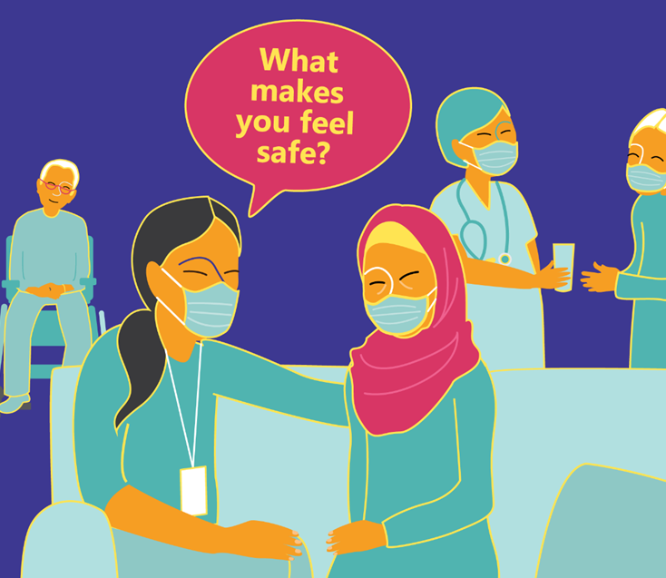
Practice of Inquiry
Notes:
The intended audience for this slide is leaders and providers
Bottom line, we can help our employees, physicians and other clinical staff adopt a curious mindset by asking questions like: "How safe is our care?" or “What can you do right now to make care safer?"
We also can help our patients /residents/clients and their care partners feel like valued and important contributors to safer care by asking questions like: “What makes you feel safe?" and "What would make you feel safer?”

Slide 25
Questions you can ask your colleagues
What does patient safety mean to you?
How is the presence of safety different from the absence of harm?
Tell me about anything that alarmed or worried you during your delivery of care
Who do you speak to when you have a safety concern or compliment?
Is our care safe or are we just lucky?
How safe is our care?
What has made you feel unsafe at work (or since we last talked)?
What do you need to make you feel safe to raise concerns about safety?
Notes:
The intended audience for this slide is leaders and providers
To help us along, here are some conversation starters that we can use when talking to our colleagues about safety.

Slide 26
Questions you can ask your patients/residents/clients and care partners
Who would you speak to if you didn’t feel safe?
What makes you feel safe?
Tell me about anything that alarmed or worried you in the past 24 hours?
What would make you feel safer?
What makes you feel unsafe?
What are your care preferences? (for example, ‘what matters to you?’)
What has made you feel unsafe at work (or since we last talked)?
Notes:
The intended audience for this slide is leaders and providers
And on this slide are conversation starters to help us talk to our patients/residents/clients and care partners

Slide 27
Patients/residents/clients and care partners
You are an important partner in delivering safe care.
You are an expert in “you”.
It is important for healthcare providers to talk to you about patient safety and it is important that you feel safe to speak up and contribute to your care.
Asking questions and sharing your concerns are ways you can help contribute to your safety.
If you are uncomfortable talking to your provider, you can ask to have an essential care partner join you.
Notes:
The intended audience for this slide is patients/residents/clients and care partners
You are an important partner in delivering safe care.
Read and embellish rest of slide.

Slide 28
Conversation starters for patients/residents/clients and care partners
I would feel safer if…
I’m concerned about my or
my loved one’s condition because …
I am uncomfortable with my or my loved one’s condition because …
I believe my safety or the safety of my loved one is at risk because...
I feel unsafe because…
What can I do to contribute to my safety?
Notes:
The intended audience for this slide is patients/residents/clients and care partners
To help support you, here are conversation starters to help you talk to your healthcare providers about the safety of your care.

Slide 29
Activities to help us kick start our new approach to safety
Host a conversation on rethinking patient safety.
Host a 'digging for dinosaurs' contest.
Learn more at a webinar hosted by Healthcare Excellence Canada.
Join Healthcare Excellence Canada’s patient safety action series.
Notes:
The intended audience for this slide is leaders and providers
To help kick-start our new approach to patient safety, let’s try these activities.
Read off the slide. More details for each activity are listed in the next 3 slides

Slide 30
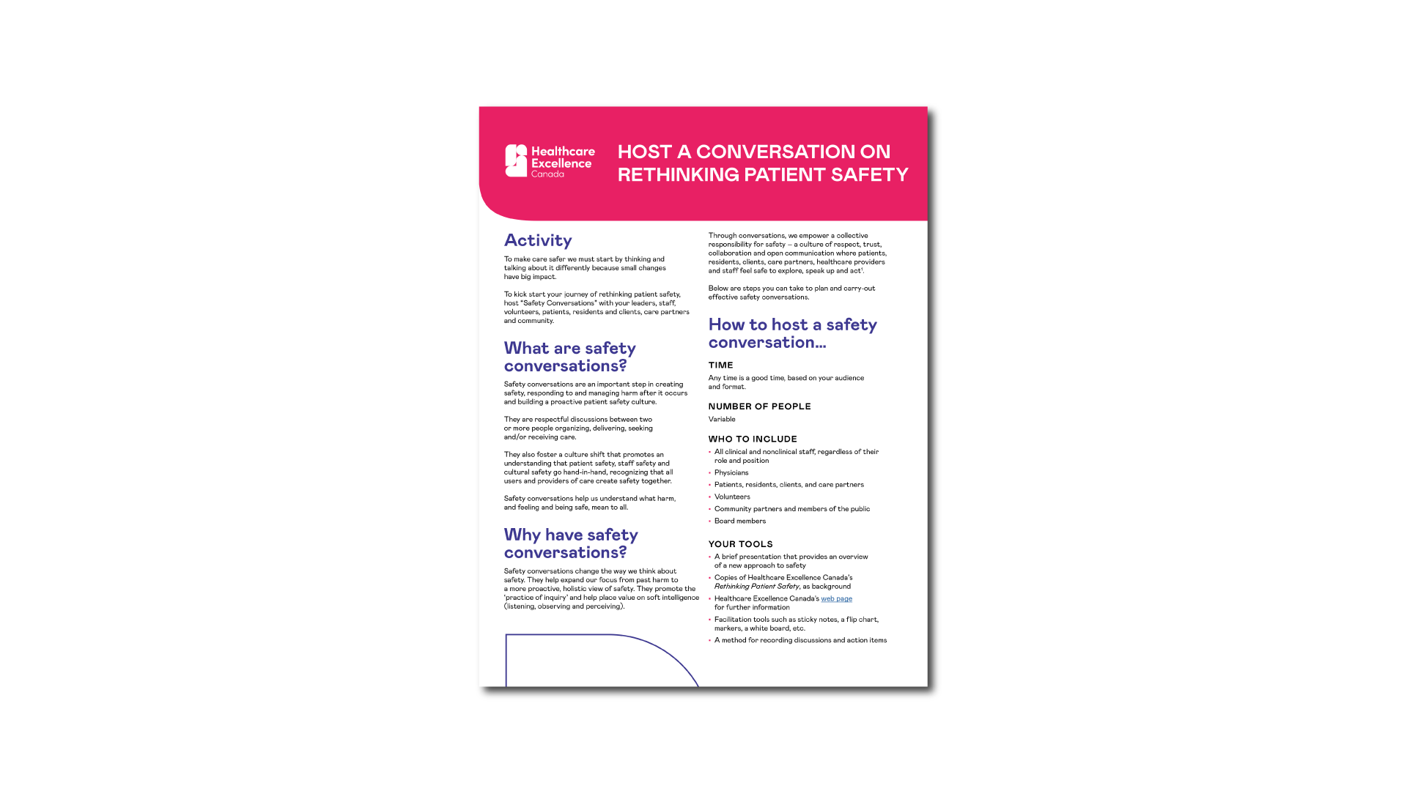
HOST A CONVERSATION ON RETHINKING PATIENT SAFETY
ExploreSaferCare.ca
Notes:
The intended audience for this slide is leaders, providers, patient advisors
To kick start our journey of rethinking patient safety, we can also consider hosting “Safety Conversations” with our leaders, staff, volunteers, patients /residents /clients, care partners and community.
Through conversations, we can empower a collective responsibility for safety – we can create a culture of respect, trust, collaboration and open communication where patients/residents/clients, care partners, healthcare providers and staff feel safe to explore, speak up and act.
Healthcare Excellence Canada has provided instructions on how to host a safety conversation and has provided suggested objectives, agenda items and questions for discussion.

Slide 31
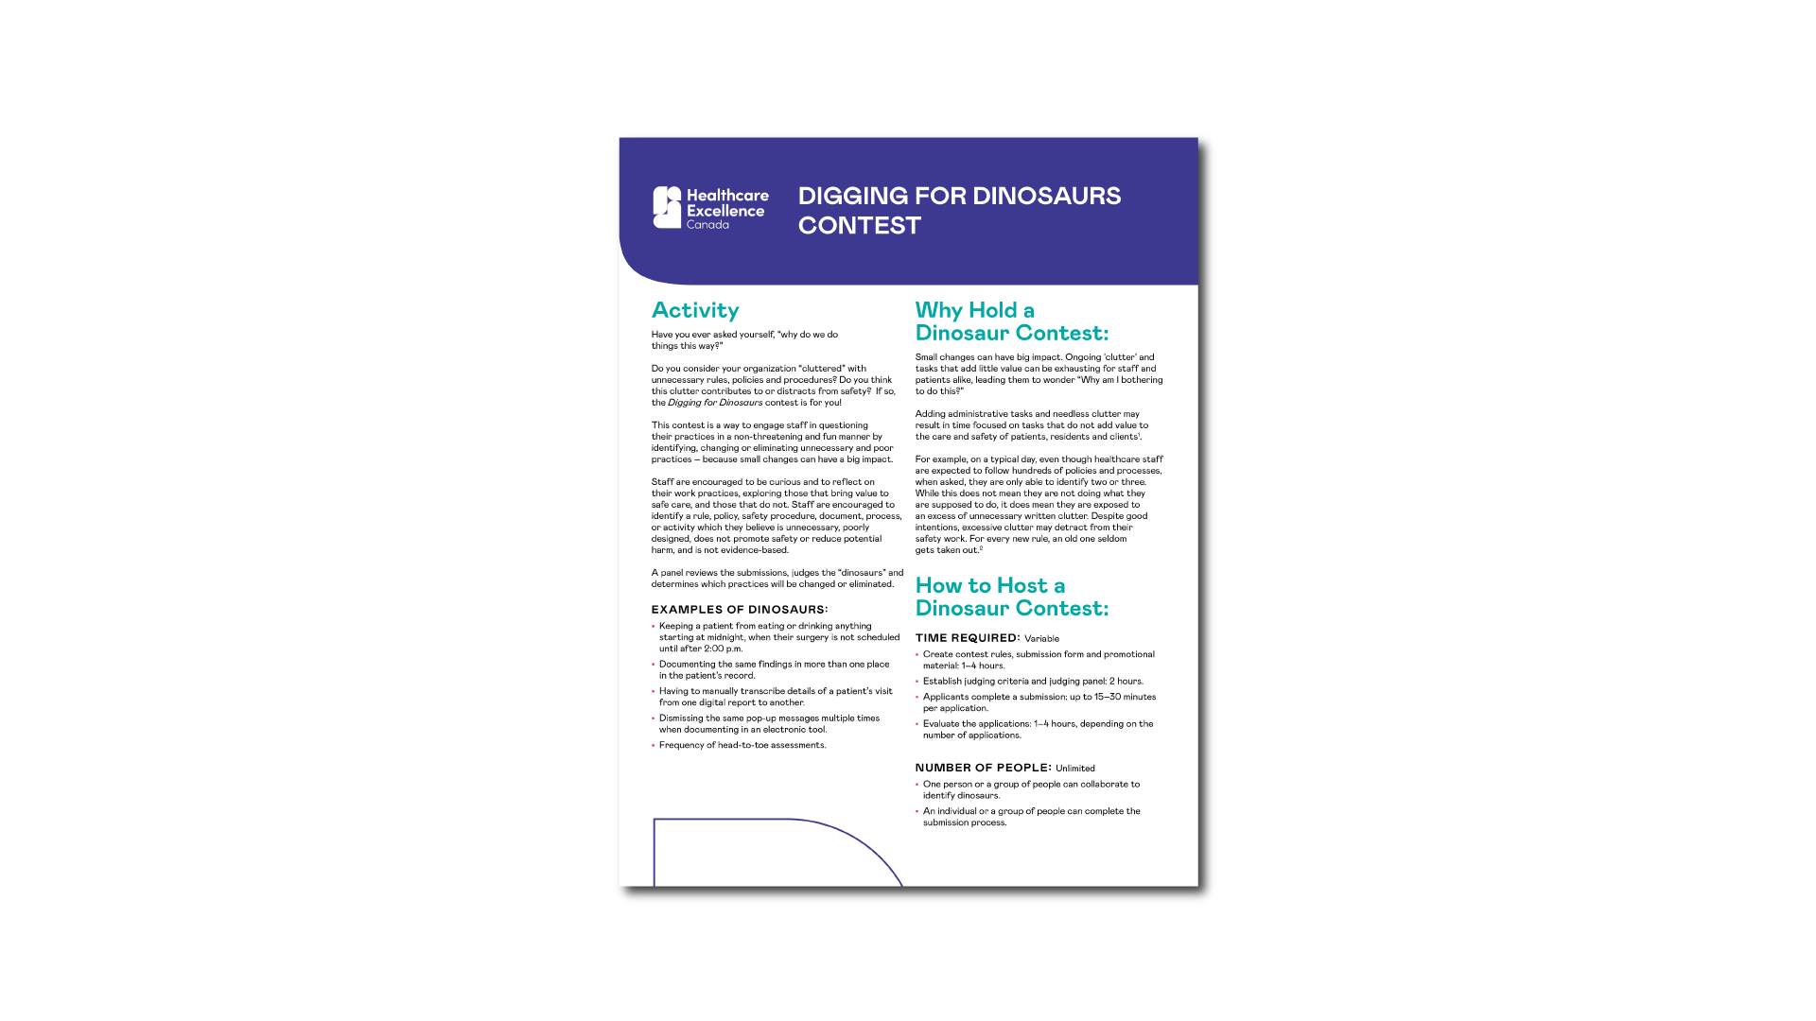
DIGGING FOR DINOSAURS CONTEST
ExploreSaferCare.ca
Notes:
The intended audience for this slide is leaders, providers, patient advisors
Have you ever asked yourself, “why do we do things this way?”
Do you consider our organization “cluttered” with unnecessary rules, policies, and procedures? Do you think this clutter contributes or distracts from safety? If so, the digging for dinosaurs contest is for us!
This contest is a way to engage our staff in questioning our practices in a non-threatening and fun manner.
Staff are encouraged to identify a rule, policy, safety procedure, document, or activity which they believe is unnecessary, poorly designed, does not promote safety or reduce potential harm and is not evidence-based.
We then have a panel review the submissions, judge the “dinosaurs”, and determines which practices will be changed or eliminated.

Slide 32
Webinar: Rethinking Patient Safety
Offered by Healthcare Excellence Canada
October 24th, 12:00 noon to 1:00 pm ET
A dynamic discussion focused on exploring, learning and acting.
Register or pick-up the recording at
ExploreSaferCare.ca
Notes:
The intended audience for this slide is leaders, providers, patient advisors to learn more about the patient safety action series
Healthcare Excellence Canada also is hosting a webinar called Rethinking Patient Safety during Canadian Patient Safety Week on October 24th
You can register at ExploreSaferCare.ca and if you missed it, you’ll be able to pick up the recording there too.
It’s a dynamic discussion focused on exploring, learning and acting to make care safer.

Slide 33
What is an Action Series?
Over four months, three virtual learning sessions.
Each learning session followed by an action period to apply learnings collectively as a team.
All participating teams share their learnings and actions at a closing congress.
Opportunities to engage in peer-to-peer learning, receive mentorship, and benefit from expert coaching to drive safer care for all.
To learn more and to apply visit
ExploreSaferCare.ca
Program starts in January, 2024
Notes:
The intended audience for this slide is leaders, providers, patient advisors to learn more about the patient safety action series
Healthcare Excellence Canada’s patient safety action series takes place over four months, with three virtual learning sessions.
Throughout, there are opportunities to engage in peer-to-peer learning, receive mentorship, and benefit from expert coaching to drive safe care for all.
There will be an action period following each virtual learning session, to apply learning collectively as a team.
Plus, all participating teams will share their learnings and actions at a closing congress.
The program starts in January, 2023. Learn more and apply by December 1st at ExploreSaferCare.ca

Slide 34
Acknowledgment
This slide deck was prepared by Healthcare Excellence Canada for use by healthcare organizations to inspire others to adopt this new approach to safety.
Healthcare Excellence Canada (HEC) works with partners to spread innovation, build capability, and catalyze policy change so that everyone in Canada has safe and high-quality healthcare. Through collaboration with patients, caregivers and people working in healthcare, we turn proven innovations into lasting improvements in all dimensions of healthcare excellence. Launched in 2021, HEC brings together the Canadian Patient Safety Institute and Canadian Foundation for Healthcare Improvement. HEC is an independent, not-for-profit charity funded primarily by Health Canada. The views expressed herein do not necessarily represent the views of Health Canada.

